Slide 1
T I T L E UART Communication System Serial Caravan Project Digital System Design Team Members: Person 1 – Om Gupta Person 2 – Nikhil Saini Person 3 - Painter Kaushalya Person 4 – Adarsh Upadhyay

Slide 2
TASKS
Person 1 – Theory & Baud Generator
Person 2 – UART Transmitter
Person 3 – UART Receiver
Person 4 – Integration & Testbench

Slide 3
O B J E C T I V E • Design UART Transmitter and Receiver • Implement baud rate generator • Perform serial communication • Verify functionality using testbench

Slide 4
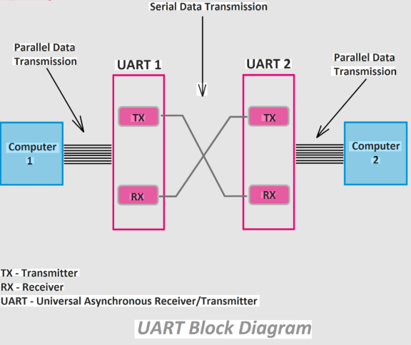

Slide 5
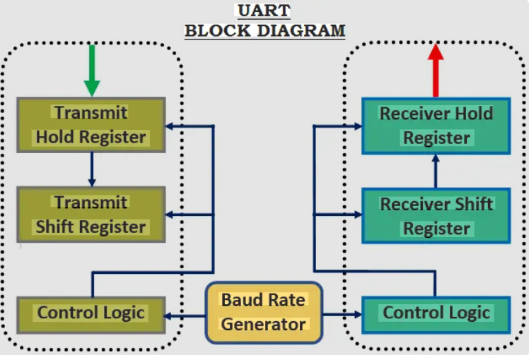

Slide 6
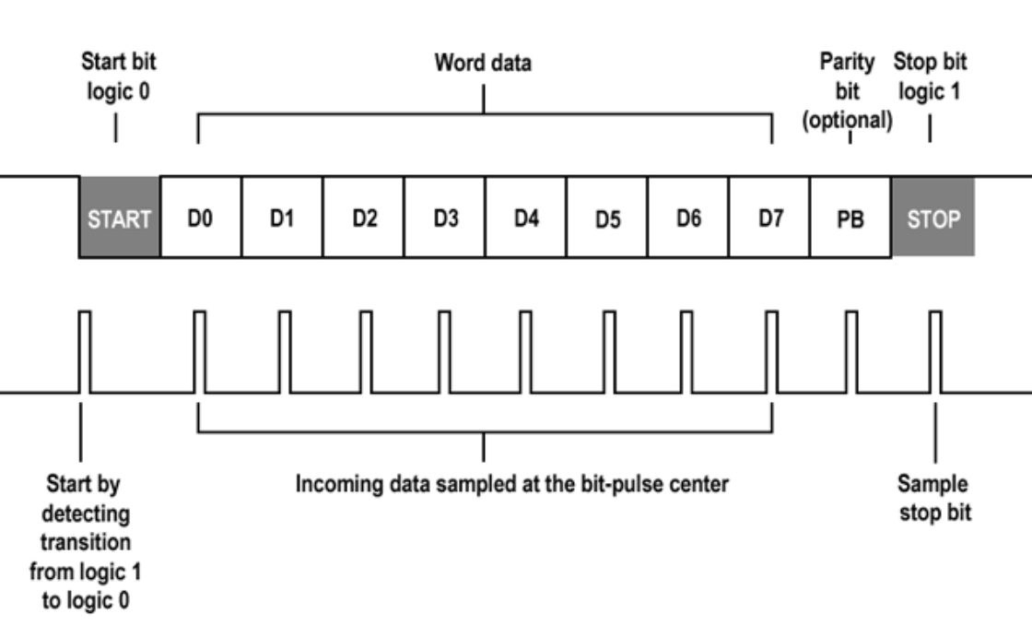
UART FRAME FORMAT Start Bit | Data (8 bits) | Parity | Stop Bit 0 | LSB → MSB | P |

Slide 7
BAUD RATE CALCULATION System Clock = 50 MHz Baud Rate = 9600(Variable) Divider = 50,000,000 / 9600 ≈ 5208

Slide 8
UART TRANSMITTER IDLE ↓ START ↓ DATA ↓ PARITY ↓ STOP

Slide 9
UART RECEIVER FSM
FSM States:
IDLE
↓
START
↓
DATA
↓
PARITY
↓
STOP
↓
DONE
.

Slide 10
TESTBENCH STRATEGY
• Clock generation • Reset initialization • Test data application • Waveform capture

Slide 11
RESULTS & WAVEFORMS
• Correct serial transmission • Data received correctly • Parity verified • rx_done asserted

Slide 12
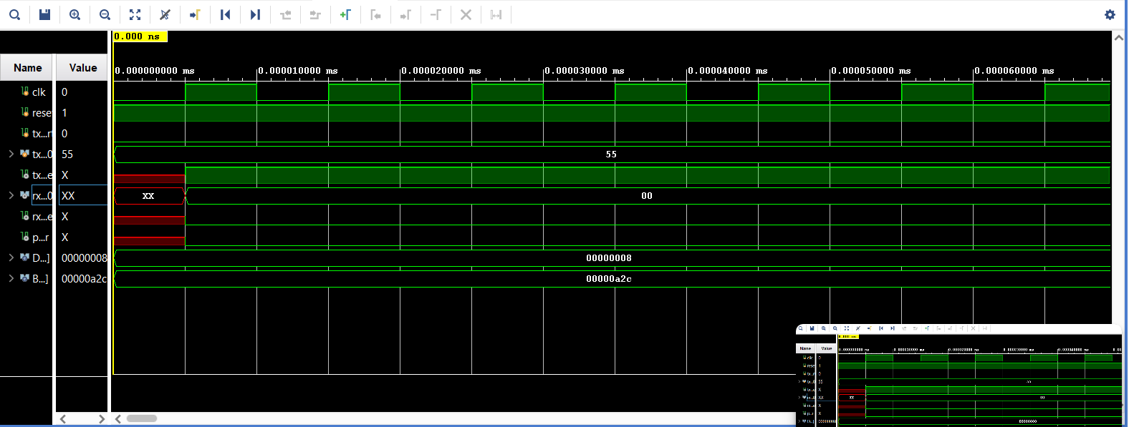

Slide 13
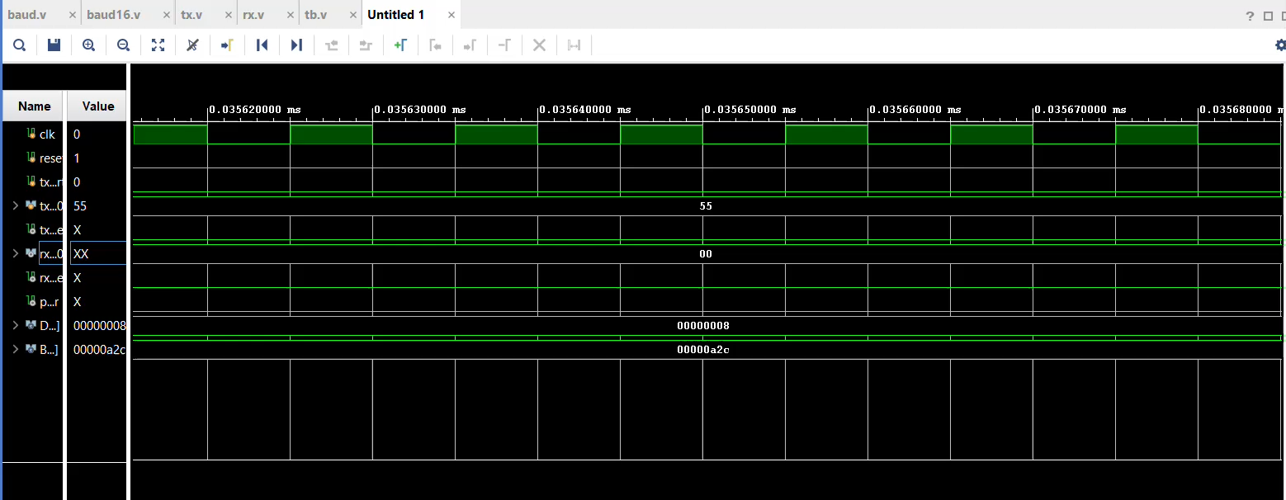

Slide 14
CONCLUSION UART Serial Caravan system was successfully designed, integrated, and verified using simulation and waveform analysis.

Slide 15
Thank You.

